Slide 1
pca
Principal Components Analysis

Slide 2
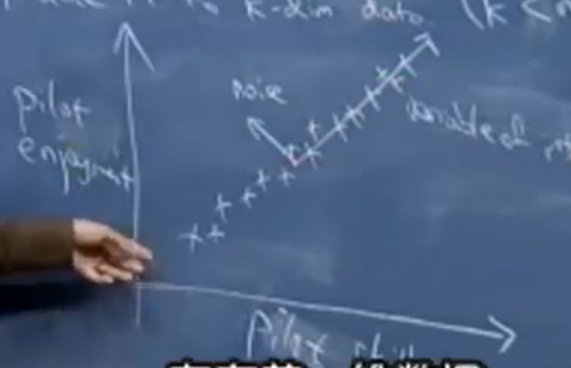
If there are vectors : x(1), x(2), … , x(m). X(i) belong to Rn.
PCA can reduce it to k dim date. (k < n).

Slide 3
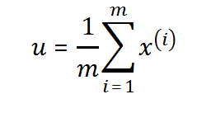
preparation
3.
1.
2.
4.

Slide 4

$‖x^{\left(i\right)}‖={\left(x^{\left(i\right)}\right)}^{T}\left(‖\vec{u}‖=1\right)$
${\sum_{i=1}^{m}{\left({\left(x^{\left(i\right)}\right)}^{T}u\right)}}^{2}=u^{T}\left[\sum_{i=1}^{m}{\left(x^{\left(i\right)}{\left(x^{\left(i\right)}\right)}^{T}\right)}\right]u$
$\begin{matrix}L\left(u,λ\right)=u^{T}Μu−λ\left(u^{T}u−1\right) \\ ∇_{u}L=Mu−λu\underset{→}{set}0\end{matrix}$
所以，当${\sum_{i=1}^{m}{\left({\left(x^{\left(i\right)}\right)}^{T}u\right)}}^{2}$取极大值时，u为M的特征值

Slide 5
选取M的最大的k个特征值
即可将数据坍缩到k维空间

Slide 6
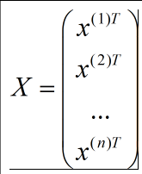
U’s columns are eigenvalues of $XX^{T}$
V ‘s columns are eigenvalues of M.
So, Top k columns of V is the top k eigenvalues of M.
[U,D,V] = svd(X). (Matlab)

