Slide 1
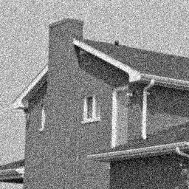
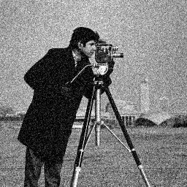
Image and video denoising by sparse 3D transform-domain collaborative filtering
Block-matching and 3D filtering (BM3D) algorithm
块匹配三维协同滤波算法

Slide 2
A novel image denoising strategy
An enhanced sparse representation in transform domain.
The enhancement of the sparsity is achieved by similar 2-D image fragments(e.g.,blocks) into 3-D data arrays which we call “groups.”
Collaborative filtering is a special procedure developed to deal with these 3-D groups.
Using the three successive steps:
1.3-D transformation of a group.
2.shrinkage of the transfom spectrum.
3.inverse 3-D transformation.
Aggregation is a particular averaging procedure which is exploited to take advantage of the redundancy.

Slide 3
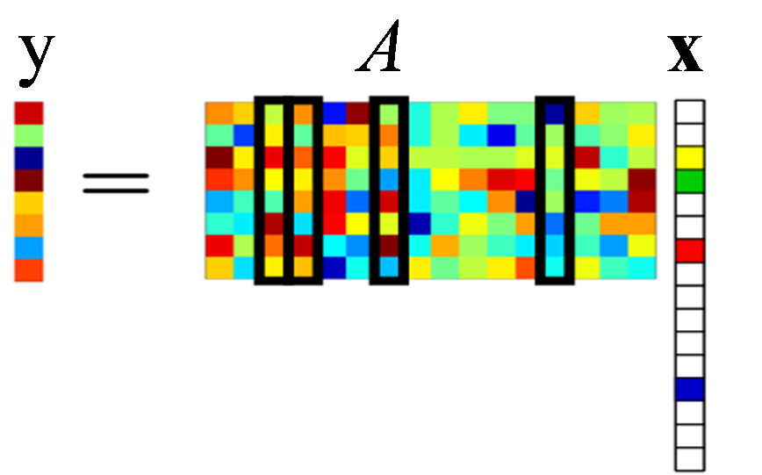
sparse representation（稀疏表示）
稀疏编码是从人的生理特性出发，从而发展起来的。人的视网膜细胞很多，但是对事物敏感的细胞单元却很少，从这点出发，我们可以对输入图像进行稀疏表示，用一组稀疏系数表示，从而达到了对图像信息的压缩。
比如把一个句子中的字母比作像素，单词比作经过稀疏表示过后的稀疏元素，那么字典就表示单词和字母的映射关系。单词和字母都可以表示这个句子，但是单词的个数是要远远小于字母的个数，这样字母到单词的转换，就是对这个句子信息的压缩。

Slide 4
Grouping
Grouping is the concept of collecting similar d-dimensional fragments of a given signal into a given signal into a d+1-dimentisonal data structure that we term “group.”
Grouping can be realized by various techniques.
The importance of grouping is to enable the use of a higher dimensional filtering of each group , which exploits the potential similarity (correlation , affinity ,e.t.c. )between grouped fragments in order to estimate the true signal in each of them.
The approach we denominate collaborative filtering.

Slide 5
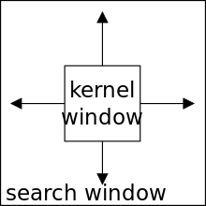
Grouping by matching
Matching is a method for finding signal fragments similar to a given reference one.
Achieving by pairwise testing
Distance is smaller than threshold
Block-matching (BM) （块匹配）is a particular matching approach that has been extensively used for motion estimation in video compression (MPEG 1, 2, and 4, and H.26x). As a particular way of grouping, it is used to find similar blocks, which are then stacked together in a 3-D array (i.e., a group).

Slide 7
Collaborative Filtering（协同滤波）
N fragment -> N estimates
Collaborative means each grouped fragment collaborates for the filtering of all others , and vice versa.
The grouped blocks exhibit perfect mutual similarity , which makes the elementwise averaging(i.e., averaging between pixels at the same relative positions) a suitable estimator.
However,perfectly identical blocks are unlikely in natural images. If nonidentical fragments are allowed within the same group, the estimates obtained by elementwise averaging become biased（有偏差）

Slide 9
Collaborative Filtering by Shrinkage in Transform Domain
Assuming –dimensional groups of similar signal fragments are already formed, the collaborative shrinkage comprises of the following steps.
Apply a d+1-dimensional linear transform to the group.
Shrink (e.g., by soft- and hard-thresholding or Wiener filtering) the transform coefficients to attenuate the noise.
Invert the linear transform to produce estimates of all grouped fragments
These groups are characterized by both:
interfragment correlation which appears between the pixels of each grouped fragment—a peculiarity of natural images;（同组内的像素）
interfragment correlation which appears between the corresponding pixels of different fragments—a result of the similarity between grouped fragments.（不同组但相同位置的像素）

Slide 10
The benefit of the collaborative shrinkage
A 2-D transform is applied separately to each individual block in a given group of n（个） fragments.
Since these grouped blocks are very similar, for any of them we should get approximately the same number, a（个） significant transform coefficients.
It means that the whole group of fragments is represented by na（个） coefficients.
If 1-D transform that across the grouped blocks has a DC-basis element, then because of the high similarity between the blocks, there are approximately only a（个） significant coefficients that represent the whole group instead of na;

Slide 11
Algorithm
The input noisy image is processed by successively extracting reference blocks from it and for each such block:
find blocks that are similar to the reference one (block matching) and stack them together to form a 3-D array (group);
perform collaborative filtering of the group and return the obtained 2-D estimates of all grouped blocks to their original locations.
After processing all reference blocks, the obtained block estimates can overlap, and, thus, there are multiple estimates for each pixel. We aggregate these estimates to form an estimate of the whole image.

Slide 15
hard-thresholding
硬阈值滤波
basic estimate

Slide 17
Collaborative Wiener Filtering
empirical Wiener shrinkage coefficients
经验维纳滤波系数

Slide 18
Aggregation Weights

Slide 19
Aggregation by Weighted Average

Slide 20
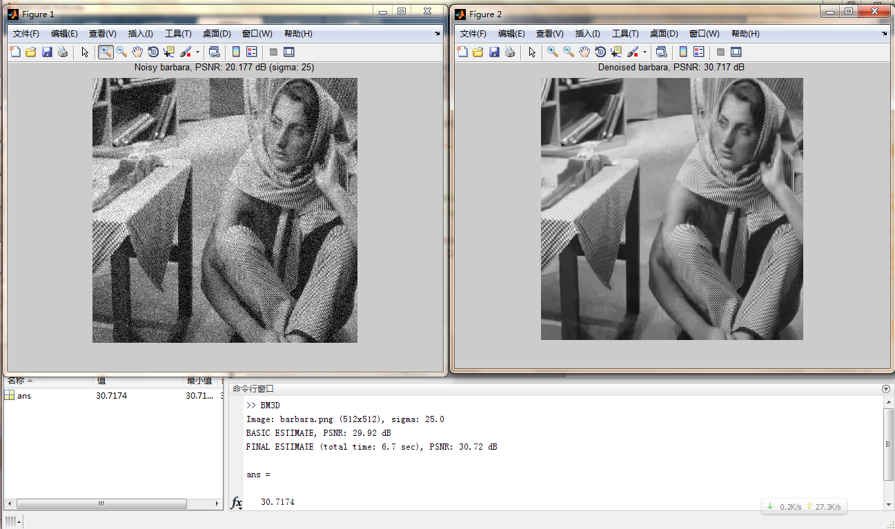

Slide 21
FAST AND EFFICIENT REALIZATION
Reduce the number of processed blocks.
Reduce the complexity of grouping.
Reduce the complexity of applying transforms.
Realize efficiently the aggregation.
Reduce the border effects.

Slide 22
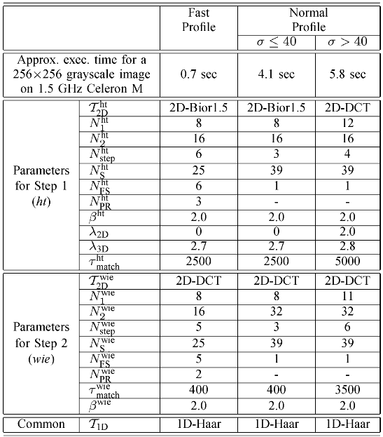

Slide 23
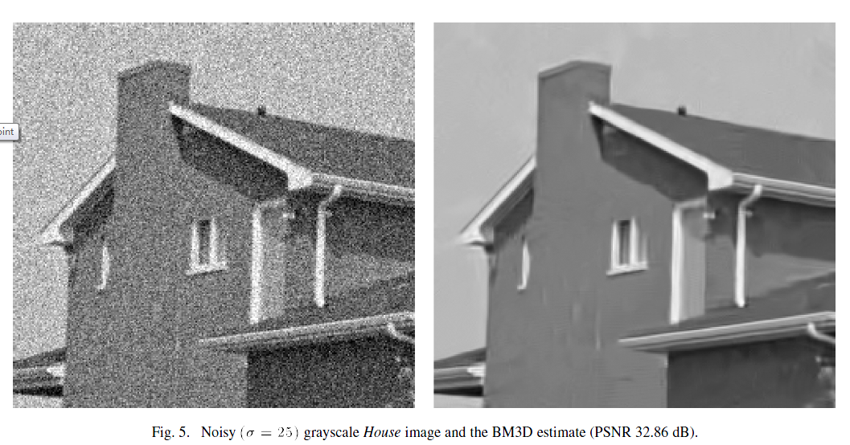

Slide 24
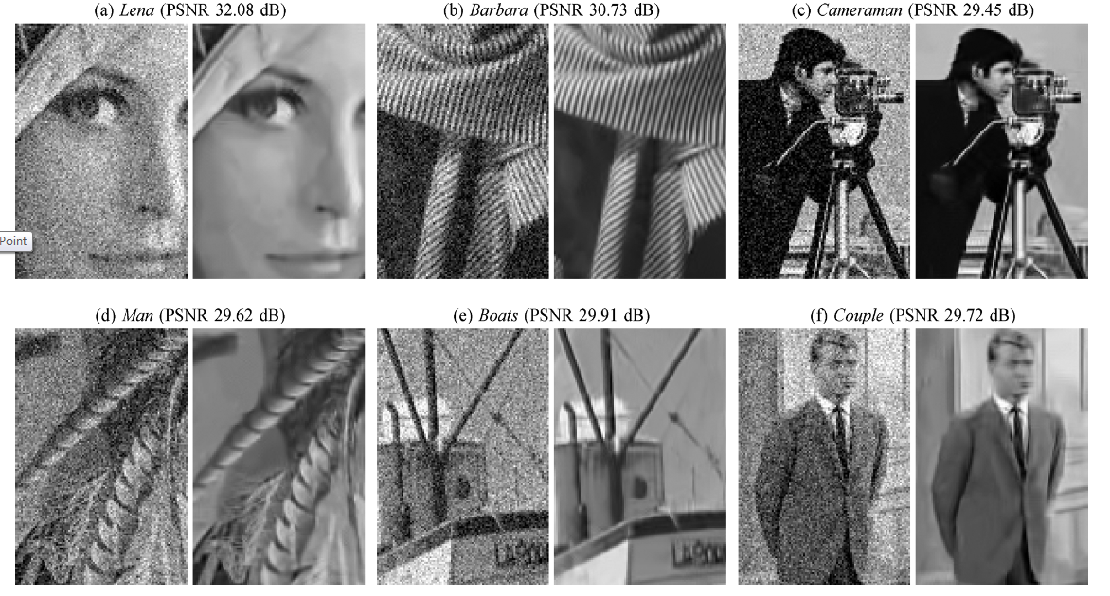

Slide 25
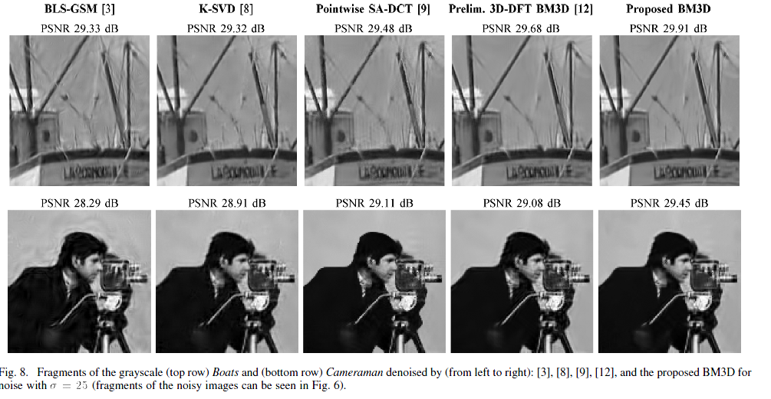

Slide 26
