Slide 1
Hardware implement
涂正中

Slide 2
2010:Convolutional Networks and Applications in Vision（Overview）
Chip:
first :1991-1992, Bell Labs’ ANNA chip.
ConvNet chip from Canon team
2009:CAVIAR ; Addressed-Event Representation (AER) convolvers
FPGA:
Vip:An fpga-based processor for image processing and neural networks(1996)
CNP:(2009)

Slide 3
ANNA chip(analog neural network arithmetic and logic unit)(1992)
in a 0.9 um CMOS technology
contains 180000 transistors on a 4.5 x 7 mm2 die
Although the chip uses analog computing internally, all input/output is digital. (mixed analog/digital)
combines the advantages of high synaptic density, high speed, low power of analog, and easy interfacing to a digital system such as a digital signal processor (DSP).

Slide 4
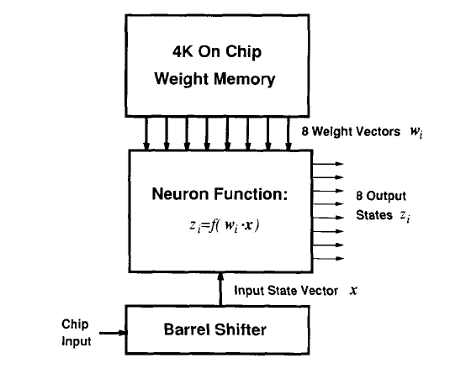
ANNA chip Architechture

Slide 5
ANNA chip application
For Handwritten digits implement
Error rate :about 5%
maximum of 10⁹ connections per second (10 GC/s), actually much lower

Slide 6
CAVIAR (Convolution AER Vision Architecture for Real-Time)
(Addressed-Event Representation,AER)卷积器不需要乘法器计算卷积
4 mixed-signal AER chips
论文太长太难（主要用AER，也不好找资料）

Slide 7
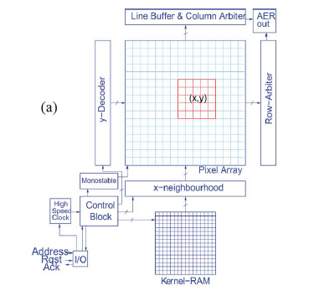
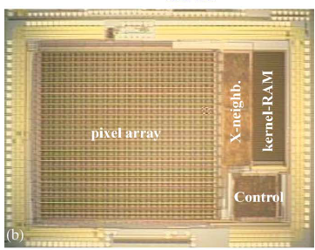
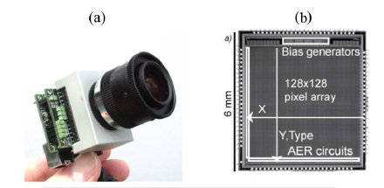
CAVIAR

Slide 8
CNP(ConvNet Processor)(2009)
A single FPGA with an external memory module

Slide 9
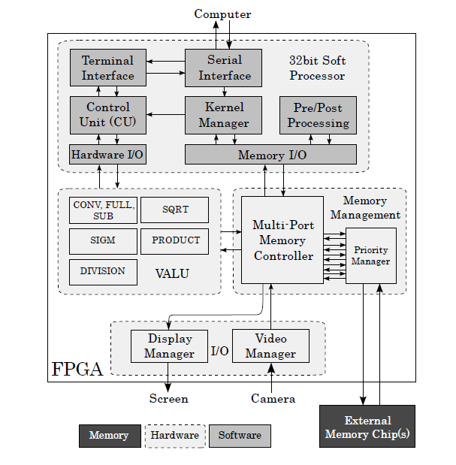
CNP Architechture

Slide 10
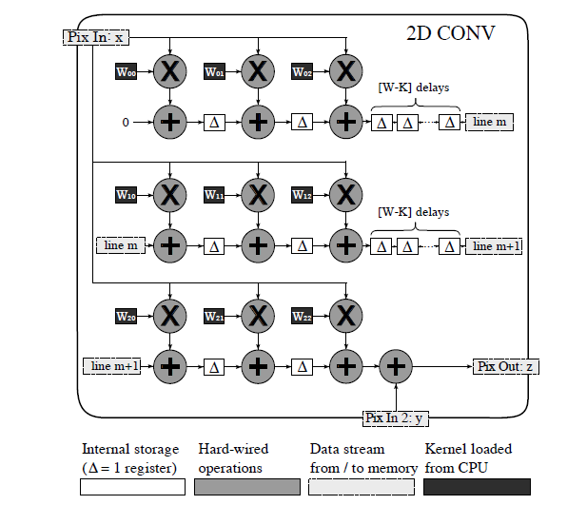
2D Conv
Parallel
pipelined
逐行扫描

Slide 11
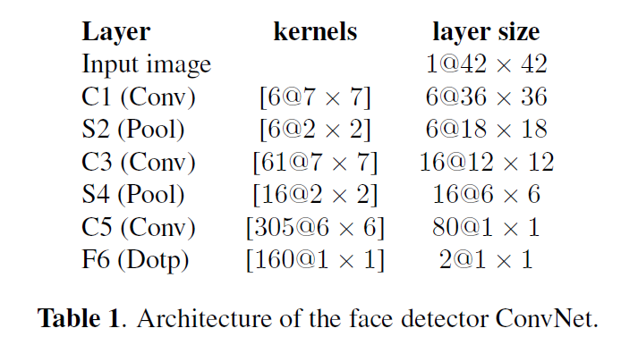
APP to face detection (Training Architecture)

Slide 12
Network Architecture
Built and trained on a computer using the Lush language,and compiled to the CNP using the automatic ConvNet compiler.
Trained on 30000 images, 15000 for testing.
Roughly 3% equal error rate after 5 epochs’ training.

Slide 13
Speed
4 billion connections per second on average
Time spent on pre/post processing and data fetcing
Process 512 X 384 greyscale image(LeNet)
---------10 frames per second

Slide 14
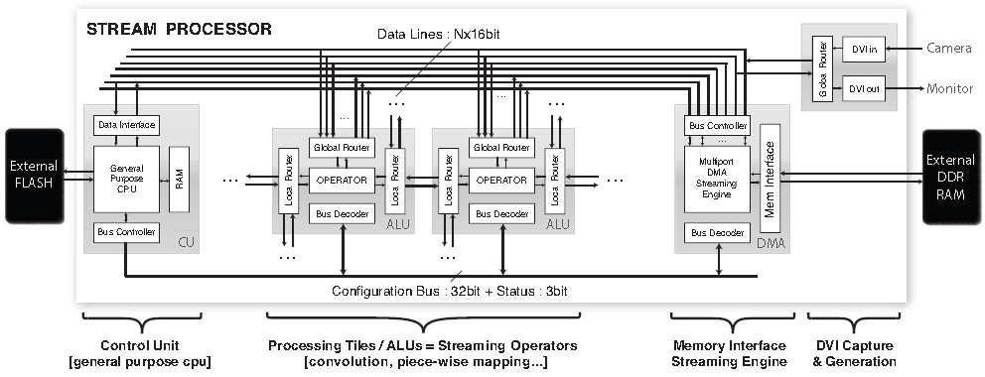
2010/Hardware Accelerated Convolutional Neural Networks

Slide 15
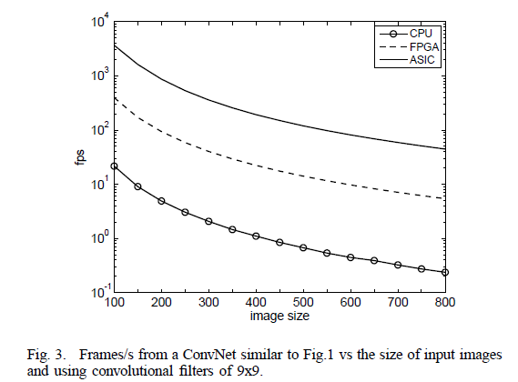
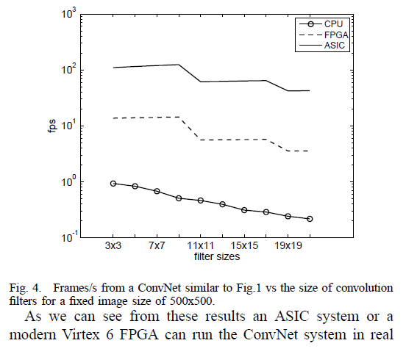
2010

Slide 16
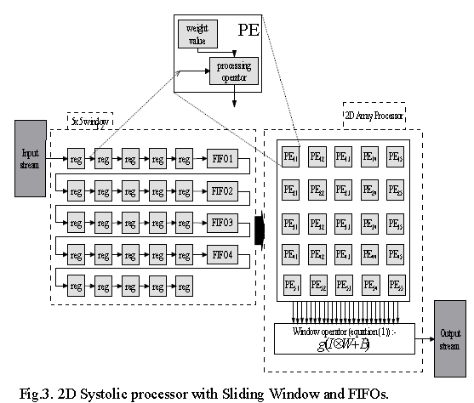
2013_ The Multi 2D Systolic Design

Slide 17
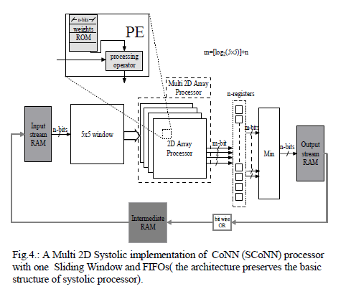
Architecture

Slide 18
Reference
ISCAS2010_Convolutional_Networks_and_Applications_in_Vision
IEEE1992_Application of the ANNA Neural Network
IEEE2009_CAVIAR_Canon corparationCAVIAR
2009_CNP_AN_FPGA_BASED_PROCESSOR_FOR_CONVOLUTIONAL_NETWORKS
ISCAS2010_Hardware_Accelerated_Convolutional_Neural
ICECS2013The_Multi_2D_Systolic_Design_and_Implementation_of_Convolutional_Neural_Networks

